Slide 1
Products Service Delivery
Release & Deployment Management
Madhusudhana Reddy Assistant Release Manager
<November, 2019>

Slide 2
Agenda
Integra Products: Release & Deployment Management
Release/Events Calendar FY’19
Milestone Reviews and Quality Gates- Checklist
Release Inventory FY’19
Development to Deployment – Workflow
Q&A

Slide 3


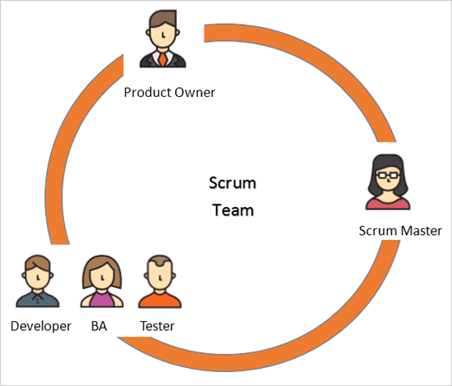



Dev Process Set up
UAT Server Results
Prod Server
Code Repository
Continuous Integration / Delivery
Company Confidential Material

Slide 4
Release Deployment Management - Products
Release Deployment Management aka “R.D.M” process manages the planning, scheduling and deploying the application releases into all Integra hosted systems / environments for Integra products/ Line of Business.
Primary objective of this process is to maintain/protect the integrity of live environment whenever code fix/ new components are introduced
Ensures all Patch/Release meets the defined quality gates and proper reviews are completed prior to roll-out into production
Ensures the Release Schedules are aligned with Integra Enterprise Product Release Calendar and key partner teams are properly communicated
Applies to all Integra products including online application.

Slide 5
Release / Events Calendar
Inclusions:
Application Patch/Release schedule for the calendar year 2019
MS patching window, DRE (ECM Reviewed), EOY (End 0f Year) control and Freeze period
* Indicates the Major application patch/release Window
4 - Major window identified for calendar year 2019 (Quarterly)
May; Aug; Oct; Feb
Minor window - Monthly Window
Rest of the month – Based on Adhoc Requests /Hotfixes/Service Packs/ exception approval/ business need.
Integra IND and Other Location Holidays 2019

Slide 6
Milestone Reviews and Quality Gates - Checklist
Purpose:
30/15/7 days Release Checkpoints, Go/No-Go and exception reviews are being set up to review the overall status of each release and its health.
Each project / all code moving into the release will be reviewed for code completion, test completion, defect status, issues, risks, etc.
Products Service Delivery Release Manager will send updates to senior level management coming out of these review meetings.
In Go/No-Go review, a recommendation will be provided to senior level management for a final Go/No-Go decision.
NO code will move into production without senior level management approval.
Products Release manager will send out an invite to all required stakeholders for all major production release window with a week notice at minimum for review. Dev, PM, BA, DEV, QA management participation required to represent change development status, testing status, defects information, etc..

Slide 7
Milestone Review and Quality Gates - Checklist
30 Day Review
(before non-client RDY install)
- Dev. PM walkthrough the list of changes that are locked down for upcoming release window
15 Day Review
(before non-client RDY install)
- Review additional changes, if added with exception approval
- SD to share the plan to complete new hardware/ software/ network requirements
- Training session status
- Code Completion – 100%
- QA testing – 80% or above
- Defects
- Client Communication - Preparedness
NCR: Go/No-Go (7-Day)
Acceptance Criteria: QA Sign off including
- Technical SME’s can participate and ask questions/more information
- Dev. PM to specify any new hardware/ software/ network requirements
- Training/Knowledge sharing requirements for new feature/ functionality/ format changes
- Code complete/Peer Reviewed
- QA test cases – Peer Reviewed
- QA testing – 20% or above
PROD: Go/No-Go
CR: Go/No-Go
Acceptance Criteria:
QA
Successful Full/Complete regression testing
Successful Functional testing
Successful Performance testing (if N/A, provide reason)
Successful upgrade testing(if N/A, provide reason)
Successful install/deploy test
NO outstanding defects in final build
FINAL build – Peer reviewed for GR
Acceptance Criteria: SD
- Successful installer logs
- Zero install/deployment issue client RDY
Successful execution of all reviewed test cases for Non-client RDY from QA end.
- NO outstanding defects in non-client RDY
SD
Successful execution of all reviewed test cases in non-client RDY.
Zero install/deployment issue in non-client RDY.
Client Communication
- Crontab Jobs - Processing & Data Workflow
- Remotes
- Client Smoke Testing(*)

Slide 8
Development to Deployment Process Notification
30/15 days Review
7 day Review
NCR
Gate#1
Client RDY
Gate#2
PROD
Gate#3
Planning
DEV & QA
Non-Client RDY
Client RDY
PROD
- Release Content(initial)
- Infrastructure Req.
- QA Test Plan
- SD Test Plan
- Knowledge Transfer
QA Sign-off
Patch/Release Deliverables
Infrastructure Req.
- Test Summary Doc
- Full Regression
- Release Content (FINAL) - - Install/Deploy Test
- - Functional Test
- Performance Test
- Upgrade Test
- Defects
QA Test -Sign-Off
SD Test -Sign-Off
Product Sign-off (optional)
SD Validation (includes)
- Jenkins(Crontab) Jobs - Processing & Data Workflow
- Remotes
Sustaining Validation
Client Smoke Test (conditional)
Production Deployment
NCR Acceptance Criteria
Review
Yes
CR Acceptance Criteria
Review
Yes
PROD
Acceptance Criteria Review
Yes
No
No
No

Slide 9
Product Release Inventory
Release Inventory spreadsheet includes ALL Products Groups Patch/ Release Changes as a record of inventory and tracking.
Release Review spreadsheet will be used for every Review meeting and link to access the document will not be changed from review to review.
Dev. PM is accountable for the fields highlighted in “purple” and keep them up to date before all review meetings
SD-change/configuration team is accountable for fields highlighted in “Grey”
Review Responsibilities:
PM – provide over health regarding projects: ex: Green, Yellow or Red, if not in Green explanation is of status and ETA to resolve back to Green.
BA – provide a brief functional overview of the project and if applicable new or modified activities, new entitlement and etc
TA – provide a brief technical overview of the project and if applicable new or modified host services, code reviews and etc
SD-change/configuration team to provide an installation/deployment updates

Slide 10
Dev/QA
Non-Client RDY
Client RDY
Conditional Client Smoke test
PROD
PIR
Client Support
30/15 day review
7 day review
R
Y
N
14
Client RDY Testing Agreement
15
Product Testing NCR Sign-Off
Product Mgmt. & SAS
3
Prioritization
4
16
Finalize contents, Release cycle
Client Communication
Resolve & Re-build
Defects?
N
13
Defects?
Defects?
N
1
2
5
Y
N
Sign Off
(NCR)
R
Y
Y
Submit tickets
Analyze & Estimate
Dev & QA
Sustaining
R
21
Sign Off
6
QA sign off
(Final Build & Patch Artifacts)
12
20
Validation
INC Mgmt/
Backout
26
Validation
(NCR)
Validation
7
Review
Release Eng.
8
22
General Release
General Availability
9
17
23
NCR
Gate#1
11
Environment Validation
CR
Gate#2
19
Environment Validation
PROD
Gate#3
25
Environment Validation
Y
R
Y
R
Service Delivery
Success ?
Success ?
Y
N
N
N
Success ?
10
18
24
Deploy Patch
NCR
Deploy Patch
CR
Deploy Patch
PROD
For reference Only
10

Slide 11

Q & A

